Slide 1

Title of the Domain: Fake News Detection Sub Batch- A1 4201:Adarsh Singh 4202:Akshit Kotnala 4208:Ankush 4214:Ashish Sable
Department of Information Technology
SEIT
Project Based Learning 2023-24

Slide 2
Problem Statement:
Developing a reliable and efficient fake news detection system that accurately distinguishes between authentic and fabricated digital content across various formats and languages. By leveraging natural language processing (NLP) techniques, the system will identify linguistic patterns, sentiment analysis, and credibility of sources to provide users with reliable information and reduce the impact of fake news on public opinion and decision-making.

Slide 3
Objectives of a fake news detection
Detect Misinformation Patterns: Utilize natural language processing (NLP) and machine learning (ML) techniques to identify patterns of misinformation and disinformation in news articles and social media posts.
Verify Sources: Verify the credibility of news sources by analyzing their history, reputation, and authority in the given domain.
Monitor Social Media: Monitor social media platforms for the spread of fake news and analyze user engagement to understand the impact of misinformation.
In order to maximize the effectiveness of fake news detection we have proposed three classifiers which are the Naive Bayes classifier, the Logistic Regression and the Random Forest classifier.
Our main aim to build this system is to detect the fake news and provide the audience/customer using this system to differentiate between fake and real news . And for this we would be using various deep learning models taken from different research papers and also using data set from Kaggle and data sets provided by web systems like data flyer etc .

Slide 4
Sr. No. | Title of Paper/Article and Source | Research papers | Finding in brief
1. | Fake News Detection Using Recent Machine Learning Algorithms | (2023) https://ieeexplore.ieee.org/document/10403584 | Fake news. It contains information that might not be properly well defined or researched or it might be non-proven information. To overcome with this, deep learning (DL) models can be used for investigating and confinement of fake news.
Notes:
subham

Slide 5
Sr. No. | Title of Paper/Article and Source | Research papers | Finding in brief
1 | Fake News Detection Using Machine Learning Approaches | 2021 https://ieeexplore.ieee.org/document/9362384 | The fake news on social media and various other media is wide spreading and is a matter of serious concern due to its ability to cause a lot of social and national damage with destructive impacts. A lot of research is already focused on detecting it because this library contains useful tools like Count Vectorizer and Tiff Vectorizer. Then, we will perform feature selection methods, to experiment and choose the best fit features to obtain the highest precision, according to confusion matrix results
Notes:
srijan

Slide 6
Sr No | Title of Paper | Research papers | Findings in Brief
3 | Fake News Detection Using Machine Learning Approaches | (2022) https://ieeexplore.ieee.org/document/9940917 | The study focuses on advancing skin cancer detection using convolution-based deep neural networks, namely VGG, CapsNet, and ResNet, which automate the feature extraction process. Overcoming the limitations of traditional machine learning, the research introduces ensemble learning to combine the decisions of these deep learners. The ensemble approach significantly improves sensitivity, accuracy, specificity, F-score, and precision for skin cancer detection compared to individual models. Notably, the findings suggest the broader applicability of this ensemble learning strategy beyond skin cancer, showcasing its potential to enhance disease detection accuracy in various medical imaging scenarios.

Slide 7
Sr. No. | Title of Paper/Article and Source | Research papers | Finding in brief
1. | FAKE NEWS DETECTION USING ML | May 2020 http://www.irjet.net/ | Fake news is described as a story that is made up with an intention to misdirect or to delude the reader. We have presented a response for the task of fake news discovery by using Deep Learning structures. We have constructed a model that gets many no of natural signs of genuine and fake news.
Notes:
subham

Slide 8
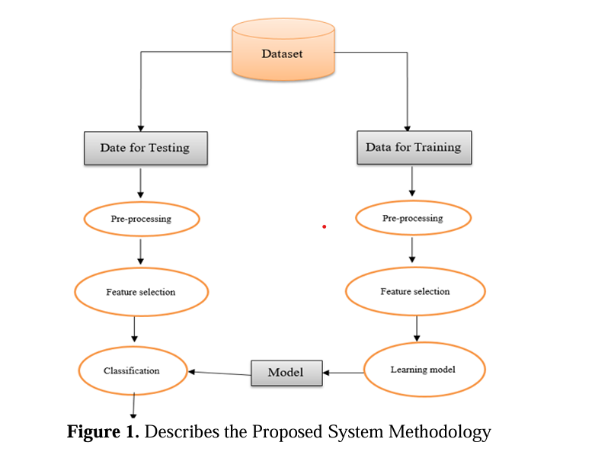
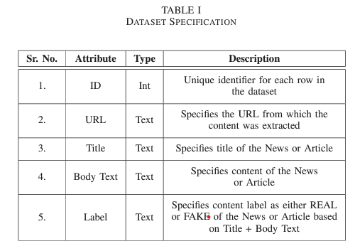
Block Diagram to detect Fake News
From - https://ieeexplore.ieee.org/document/9362384
From - https://ieeexplore.ieee.org/document/9362384

Slide 9
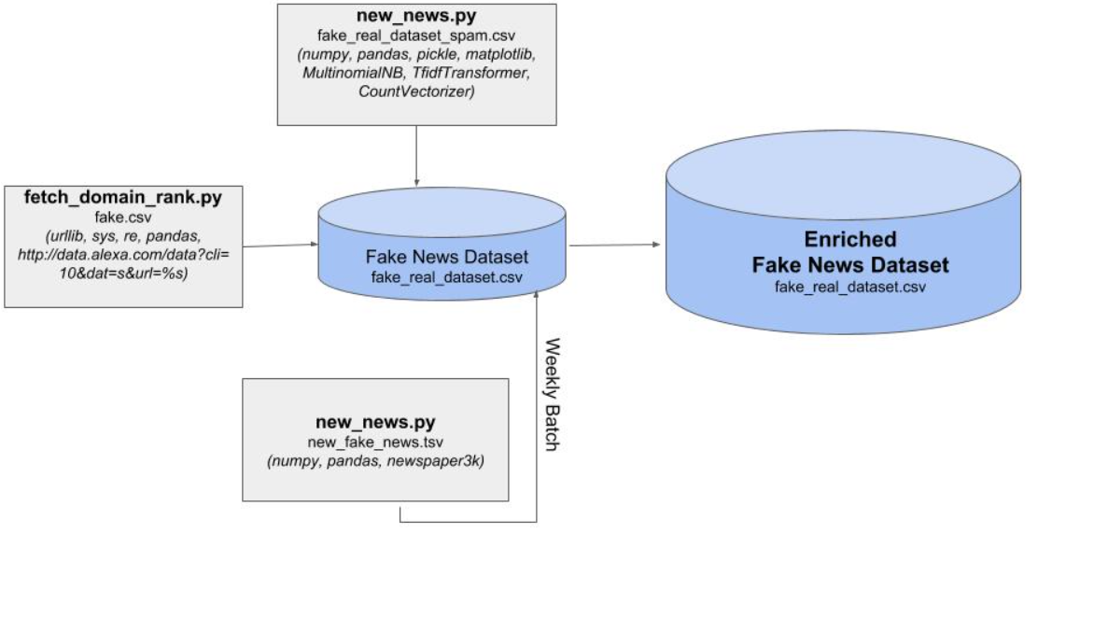
https://ieeexplore.ieee.org/document/9940917

Slide 10
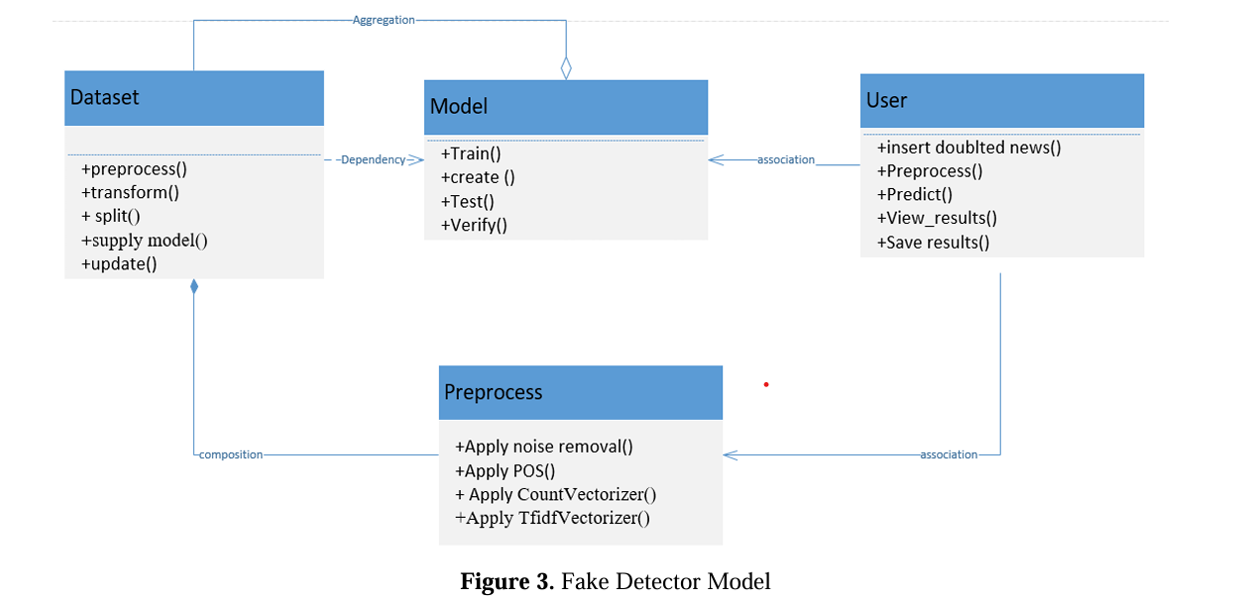
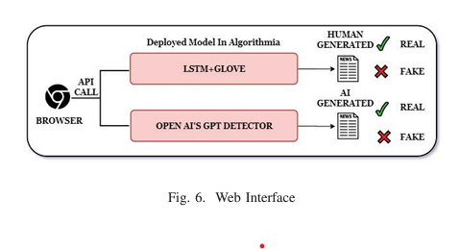
https://ieeexplore.ieee.org/document/10314520

Slide 11
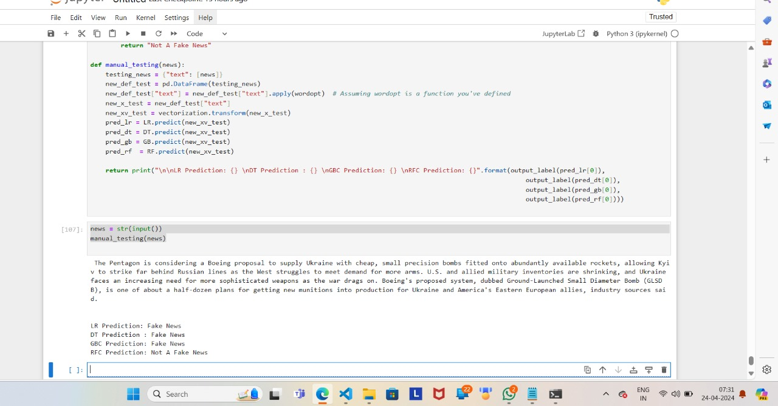
. METHODOLOGY AND IMPLEMENTATION
Data Preprocessing:
Data set was not even readable format so performed tons of data preprocessing (cleansing, formatting, selection, transformation etc.
Data Enrichment:

Slide 12
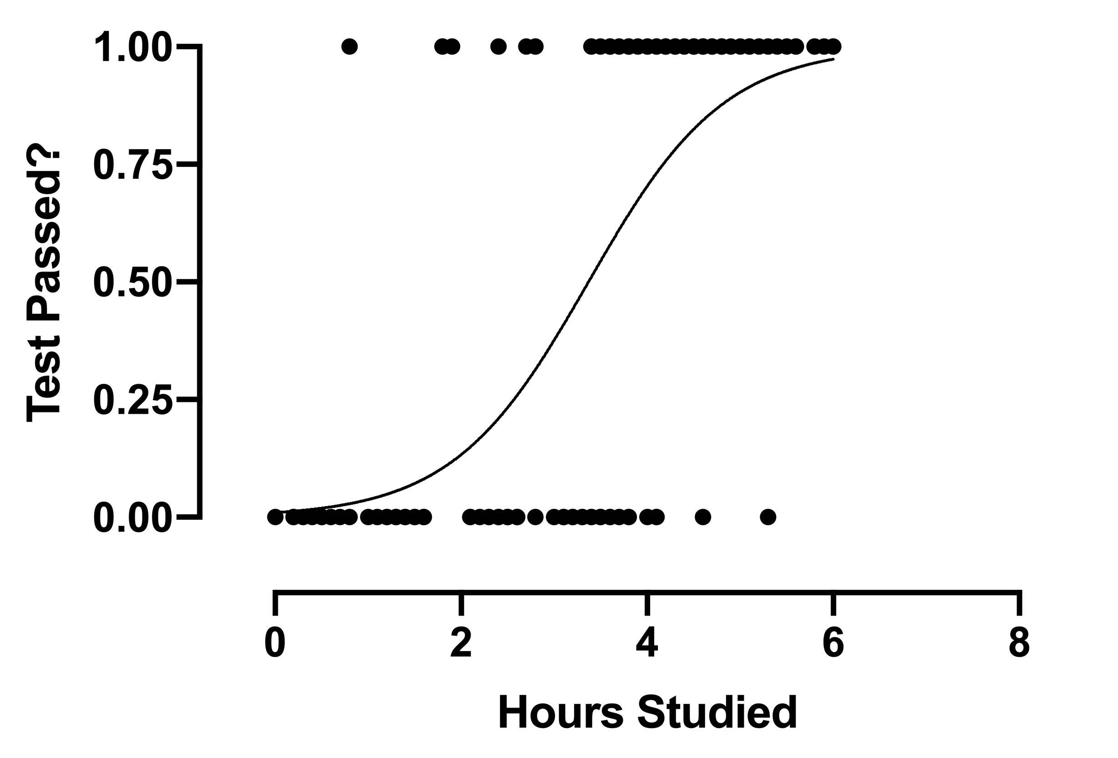
Algorithms used :- 1. Logistic Regression
Logistic regression is a supervised machine learning algorithm used for classification tasks where the goal is to predict the probability that an instance belongs to a given class or not.
It predicts the output of a categorical dependent variable. Therefore, the outcome must be a categorical or discrete value.
It can be either Yes or No, 0 or 1, true or False, etc
The model takes the numerical features extracted from the text as input and predicts the probability of each sentiment class (positive, negative, neutral).
Logistic regression calculates the probability of each sentiment class using a logistic function. It then assigns the class with the highest probability as the predicted sentiment polarity.

Slide 13
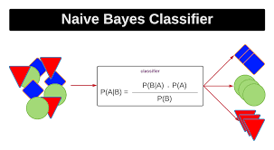
Naïve Bayes Algorithm
Naive Bayes classifiers are a collection of classification algorithms based on Bayes’ Theorem. It is not a single algorithm but a family of algorithms where all of them share a common principle, i.e. every pair of features being classified is independent of each other.

Slide 14
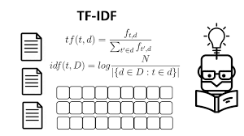
TF-IDF (Term Frequency-Inverse Document Frequency)
TF-IDF is a weighting system that assigns a weight to each word in a document based on its term frequency (tf) and the reciprocal document frequency (tf) (idf). The words with higher scores of weight are deemed to be more significant.
the TF-IDF weight consists of two terms-
Normalized Term Frequency (tf)
Inverse Document Frequency (idf)
tf-idf(t, d) = tf(t, d) * idf(t)

Slide 15
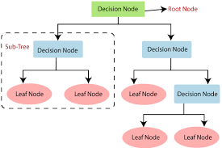
Decision Tree
It is a popular and powerful supervised machine learning algorithm used for both regression and classification tasks. It works by recursively splitting the dataset into subsets based on the most significant feature at each node of the tree. This process creates a tree-like structure where the leaves represent the class labels or regression values.
The process of forming a decision tree involves recursively partitioning the data based on the values of different attributes. The algorithm selects the best attribute to split the data at each internal node, based on certain criteria such as information gain or Gini impurity. This splitting process continues until a stopping criterion is met, such as reaching a maximum depth or having a minimum number of instances in a leaf node.

Slide 16
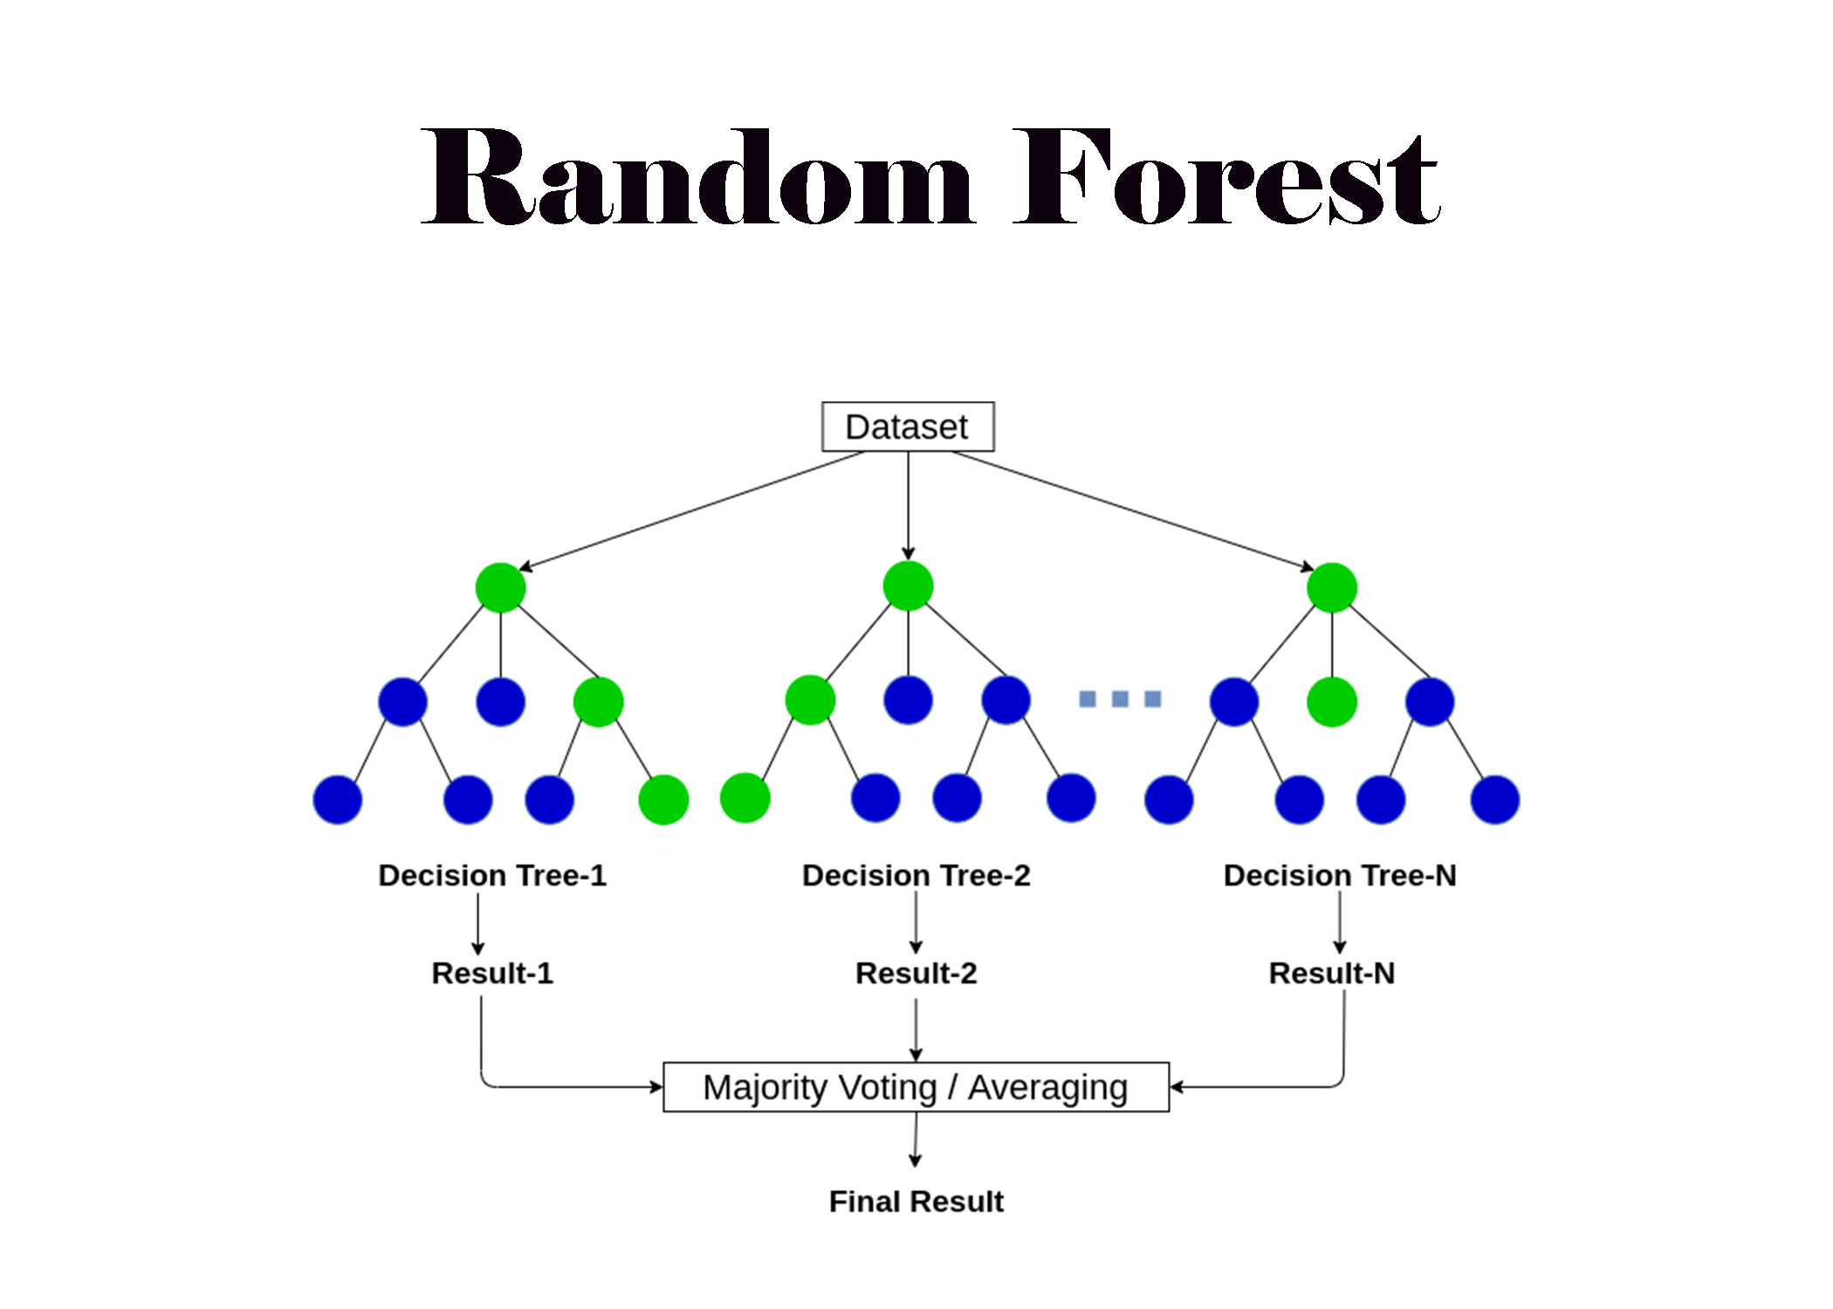
Random Forest
It is a popular machine learning algorithm used for both classification and regression tasks. It is an ensemble learning method that operates by constructing a multitude of decision trees during training and outputs the class that is the mode of the classes (classification) or the mean prediction (regression) of the individual trees.

Slide 17
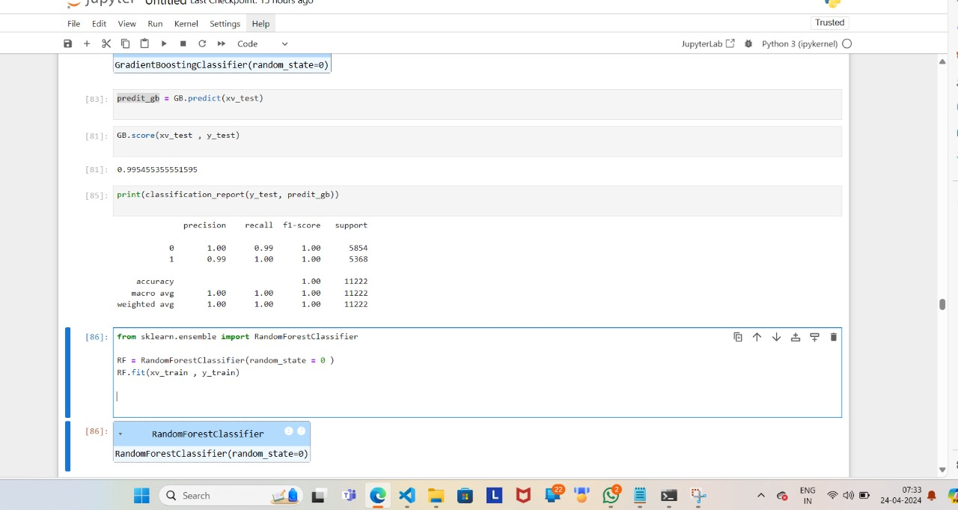
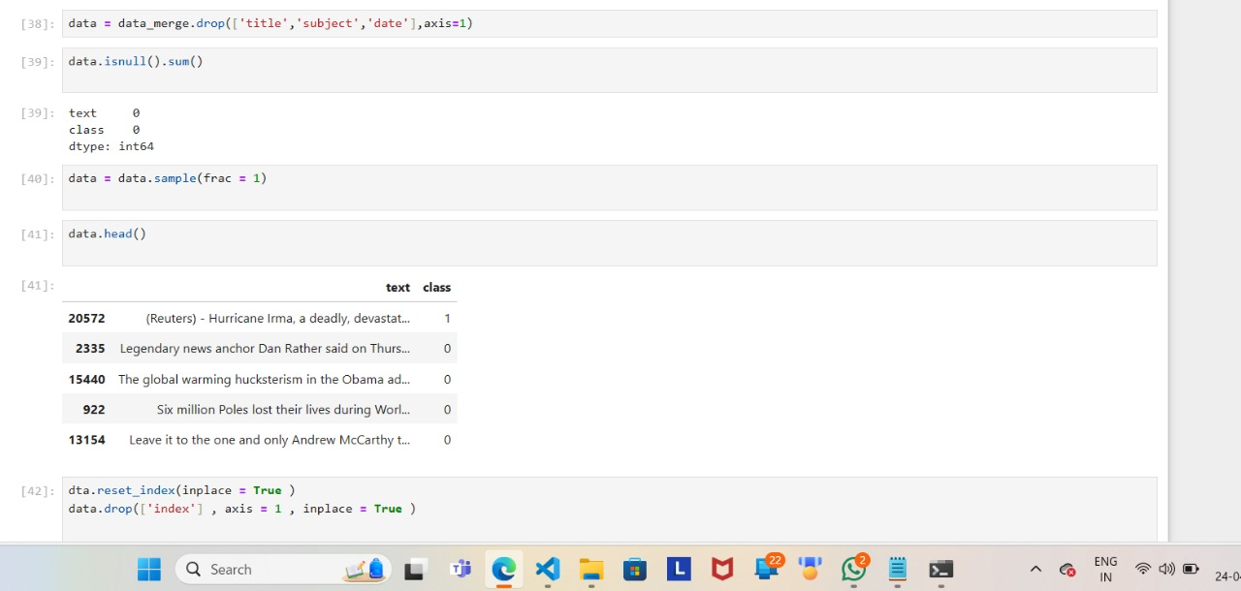
Code Snippets

Slide 18
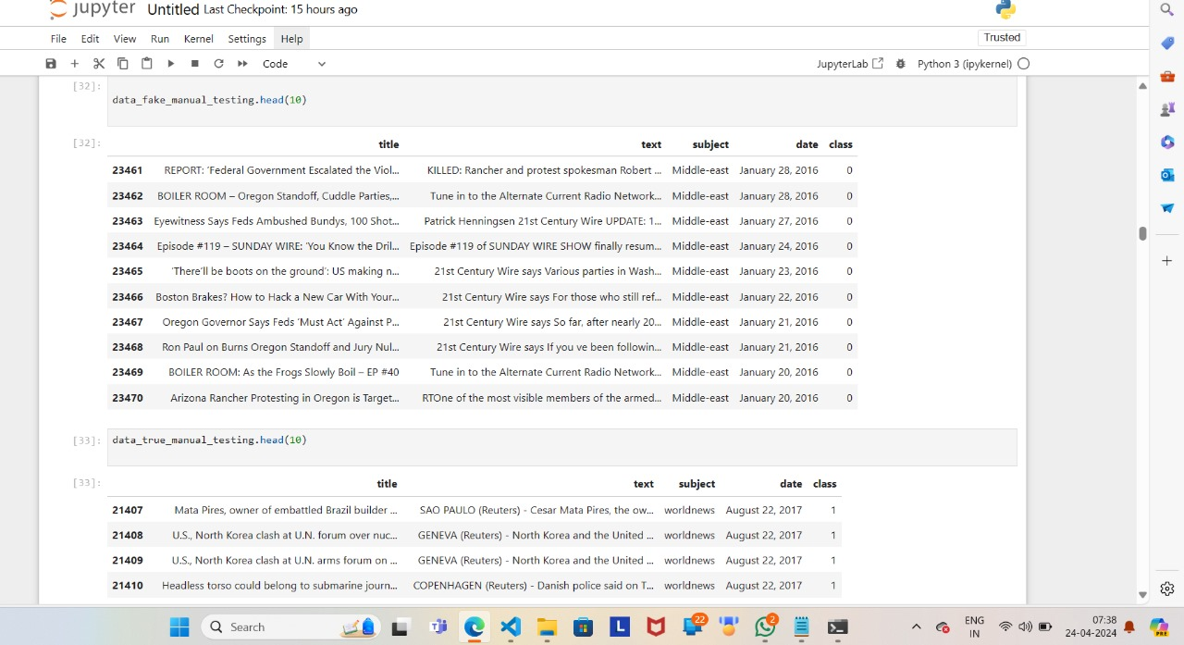

Slide 19
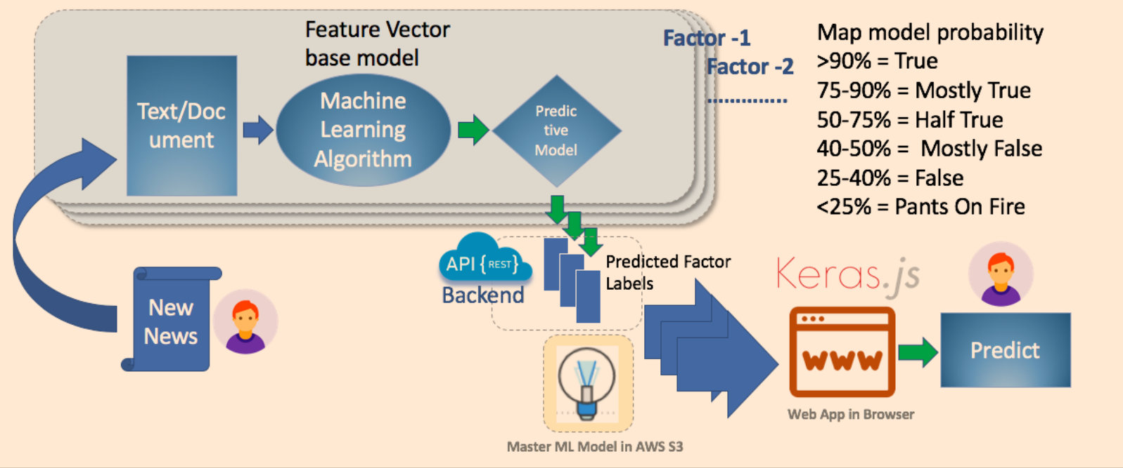
Production deployment:

Slide 20
#References
1. YouTube Tutorials for Conceptual Understanding:
- Utilized YouTube for comprehensive tutorials on machine learning concepts.
- Benefited from visual explanations to enhance understanding.
2. IEEE Site for In-Depth Research Papers:
- Explored IEEE Xplore for accessing authoritative research papers on machine learning.
- Leveraged academic and peer-reviewed content for in-depth knowledge.
3. Algorithm Exploration on Kaggle:
- Engaged with Kaggle platform for practical implementation and exploration of various machine learning algorithms.
- Accessed diverse datasets and participated in data science competitions.
4. Google and Various Websites for Additional References:
- Conducted extensive searches on Google and other reputable websites.
- Gathered supplementary materials, articles, and insights to complement learning.
5. Community Forums and Blogs for Practical Insights:
- Engaged with community forums and blogs related to machine learning.
- Leveraged practical experiences and tips shared by professionals and enthusiasts.

Slide 21
Thank You

